Slide 1

Parallel & Distributed Computing Lecture Week 3: Amdahl’s Law and Profiling
Farhad M. Riaz
Farhad.Muhammad@numl.edu.pk
Department of Computer Science
NUML, Islamabad

Slide 2









FLOPS
Floating point operations per second
Measure of theoretical peak performance

Slide 3
FLOPS
Servers are the only computers that sometimes have more than one socket; for most home computers (desktop or
laptop), “sockets” will be 1.
Cores per socket depends on your CPU. It could be 2 (dual- core), 3, 4 (quad-core), 6 (hexa-core), or 8. There are some prototype CPUs with as many as 80 cores.
“Clock cycles per second” refers to the speed of your CPU. Most modern CPUs are rated in gigahertz. So 2 GHz would be 2,000,000,000 clock cycles per second.
The number of FLOPs per cycle also depends on the CPU. One of the fastest (home computer) CPUs is the Intel Core i7–970, capable of 4 double-precision or 8 single-precision floating-point operations per cycle.

Slide 4
Test
Intel Core i7–970 has 6 cores. If it is running at 3.46 GHz and can perform 8 floating point operations per second, calculate the theoretical compute power of this machine.

Slide 5
Example
Intel Core i7–970 has 6 cores. If it is running at
3.46 GHz, the formula would be:
1 (socket) * 6 (cores) * 3,460,000,000 (cycles per second) * 8 (single-precision FLOPs per second) = 166,080,000,000 single-precision FLOPs per second or 83,040,000,000 double- precision FLOPs per second.
109 GFLOPS.

Slide 6
Speedup calculations
Ratio
%age
Upper bounds on speedup

Slide 7







Amdahl’s Law
Theoretical speedup calculations
where
S_{latency} is the theoretical speedup of the execution of the whole task;
s is the speedup of the part of the task that benefits from improved system resources;
p is the proportion of execution time that the part benefiting from improved resources originally occupied.

Slide 8
Example 1
If 30% of the execution time may be the subject of a speedup, p will be 0.3; if the improvement makes the affected part twice as fast, s will be 2. Amdahl's law states that the overall speedup of applying the improvement will be?

Slide 9
Example 2
Assume that we are given a serial task which is split into four consecutive parts, whose percentages of execution time are p1 = 0.11, p2 = 0.18, p3 = 0.23, and p4 = 0.48 respectively. Then we are told that the 1st part is not sped up, so s1 = 1, while the 2nd part is sped up 5 times, so s2 = 5, the 3rd part is sped up 20 times, so s3 = 20, and the 4th part is sped up 1.6 times, so s4 = 1.6. By using Amdahl's law, the overall speedup is?

Slide 10
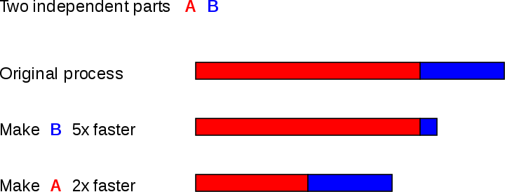
Amdahl’s Law

Slide 11
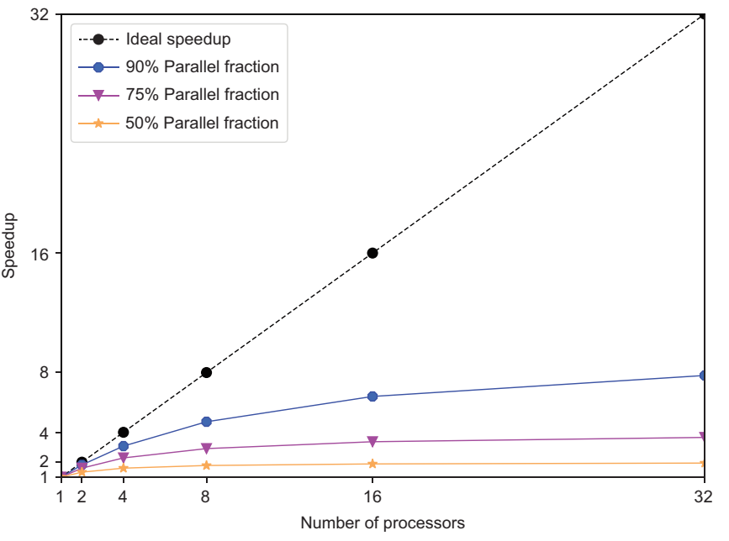

Slide 12
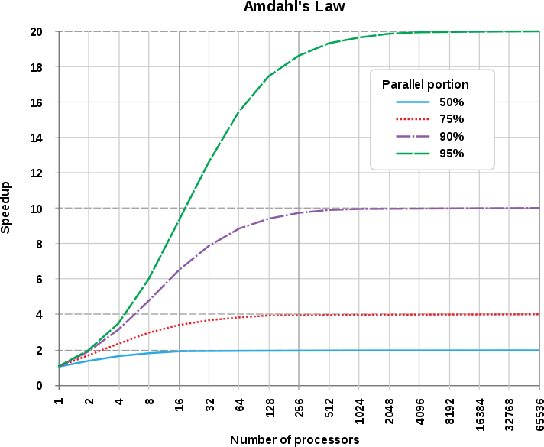

Slide 13
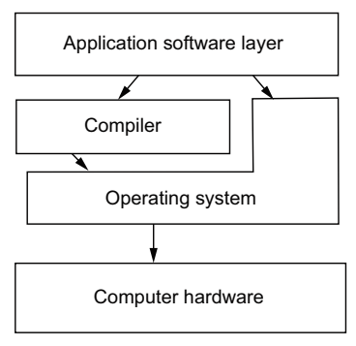
How does parallel computing works?
As a developer, you are responsible for the application software layer, which includes your source code.
In the source code, you make choices about the programming language and parallel software interfaces you use to leverage the underlying hardware.
Additionally, you decide how to break up your work into parallel units.
Approaches a developer can take into
Process-based parallelization
Thread-based parallelization
Vectorization
Stream (GPU) processing
Notes:
Parallelization based on individual processes with their own memory spaces can be distributed memory on different nodes of a computer or within a node. Stream processing is generally associated with GPUs. The model for modern hardware and application software will help you better understand how to plan to port your application to current parallel hardware.

Slide 14
Example for Sample Application
Perform the computation on a regular two-dimensional (2D) grid of rectangular elements or cells.
The steps prepare for the calculation are
Discretize (break up) the problem into smaller cells or elements
Define a computational kernel (operation) to conduct on each element
Add the following layers of parallelization on CPUs and GPUs to perform the calculation:
Vectorization
Threads
Processes
Off-loading the calculation to GPUs
Notes:
Vectorization—Work on more than one unit of data at a time – Threads —Deploy more than one compute pathway to engage more processing cores – Processes—Separate program instances to spread out the calculation into separate memory spaces – Off-loading the calculation to GPUs—Send the data to the graphics processor to calculate

Slide 15
Complexity
In general, parallel applications are much more complex than corresponding serial applications.
Not only do you have multiple instruction streams executing at the same time, but you also have data flowing between them.
The costs of complexity are measured in programmer time in virtually every aspect of the software development cycle:
Design
Coding
Debugging
Tuning
Maintenance
Adhering to "good" software development practices is essential when working with parallel applications - especially if somebody besides you will have to work with the software.

Slide 16
Portability
Thanks to standardization in several APIs, such as MPI, POSIX threads, and OpenMP, portability issues with parallel programs are not as serious as in years past.
All of the usual portability issues associated with serial programs apply to parallel programs. For example, if you use vendor "enhancements" to Fortran, C or C++, portability will be a problem.
Even though standards exist for several APIs, implementations will differ in a number of details, sometimes to the point of requiring code modifications in order to effect portability.
Operating systems can play a key role in code portability issues.
Hardware architectures are characteristically highly variable and can affect portability.

Slide 17
Resource Requirements
The primary intent of parallel programming is to decrease execution wall clock time, however in order to accomplish this, more CPU time is required. For example, a parallel code that runs in 1 hour on 8 processors actually uses 8 hours of CPU time.
The amount of memory required can be greater for parallel codes than serial codes, due to the need to replicate data and for overheads associated with parallel support libraries and subsystems.
For short running parallel programs, there can actually be a decrease in performance compared to a similar serial implementation. The overhead costs associated with setting up the parallel environment, task creation, communications and task termination can comprise a significant portion of the total execution time for short runs.

Slide 18
Scalability
Two types of scaling based on time to solution: strong scaling and weak scaling.
Strong scaling:
The total problem size stays fixed as more processors are added.
Goal is to run the same problem size faster
Perfect scaling means problem is solved in 1/P time (compared to serial)
Weak scaling:
The problem size per processor stays fixed as more processors are added. The total problem size is proportional to the number of processors used.
Goal is to run larger problem in same amount of time
Perfect scaling means problem Px runs in same time as single processor run

Slide 19
That’s all for today!!

